Slide 1
Using Question leveling to help students achieve better results
Targeted Review:

Slide 2
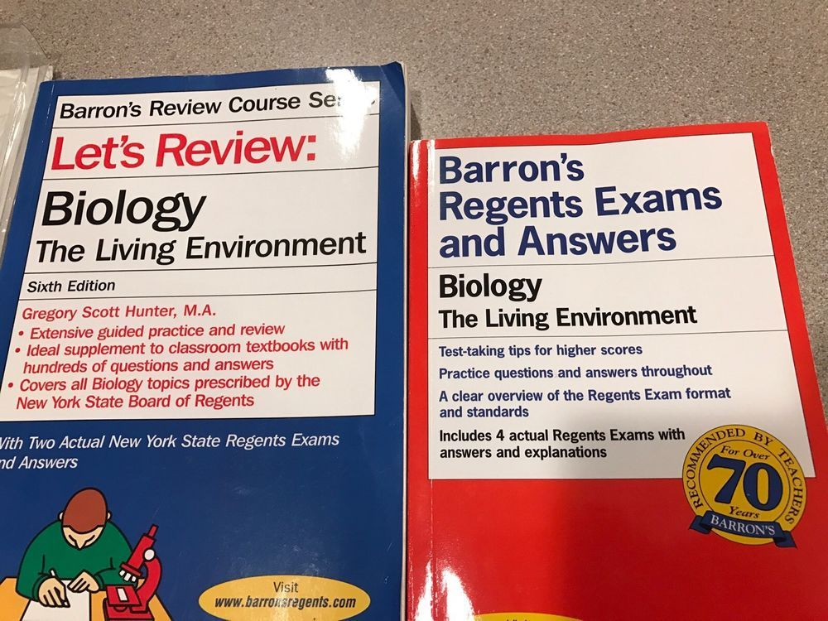

Slide 3
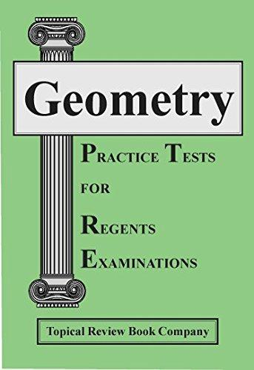
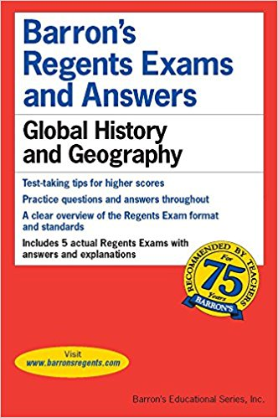

Slide 4
Types of ReView
Teacher Made
Good
Regents Questions
Better
Targeted QUestions
Even
Better!

Slide 5


Slide 6


Slide 7
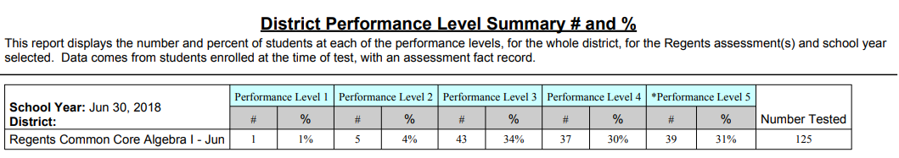
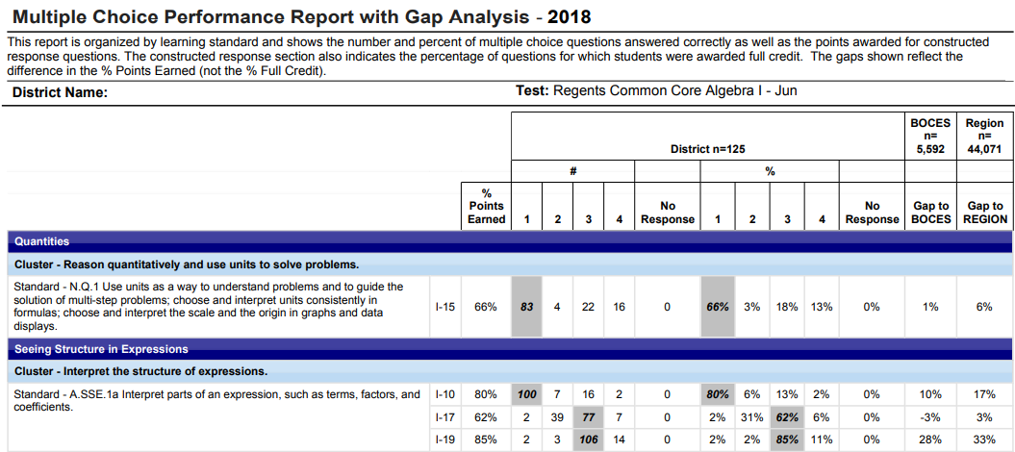

Slide 8
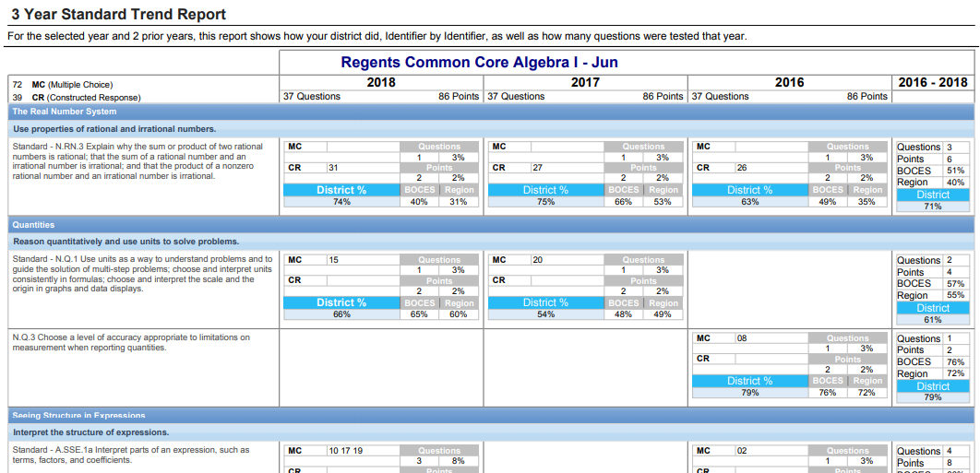

Slide 9
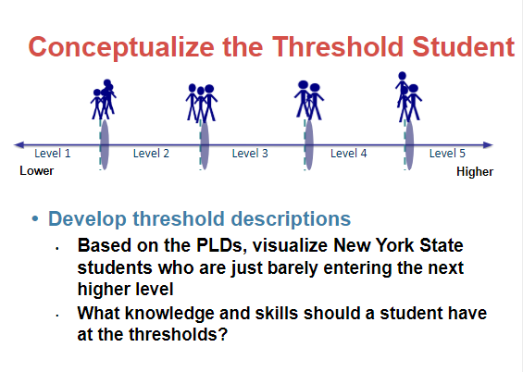

Slide 10
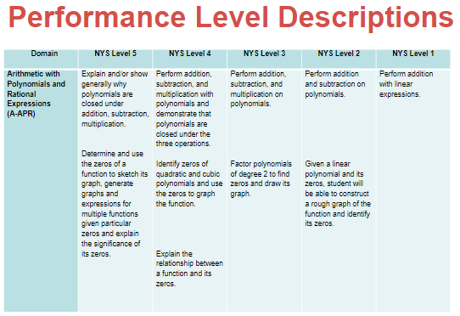

Slide 11
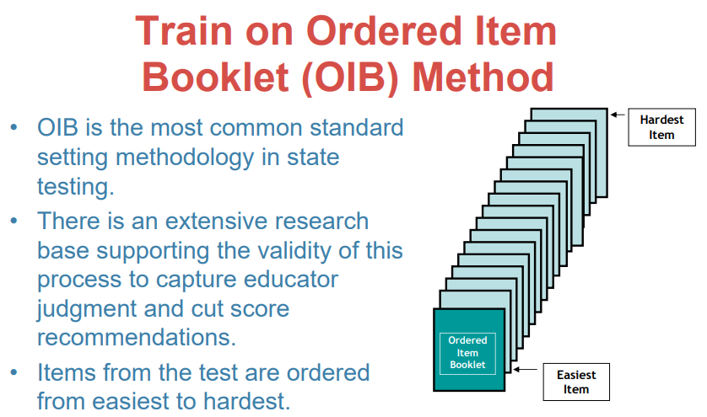

Slide 12
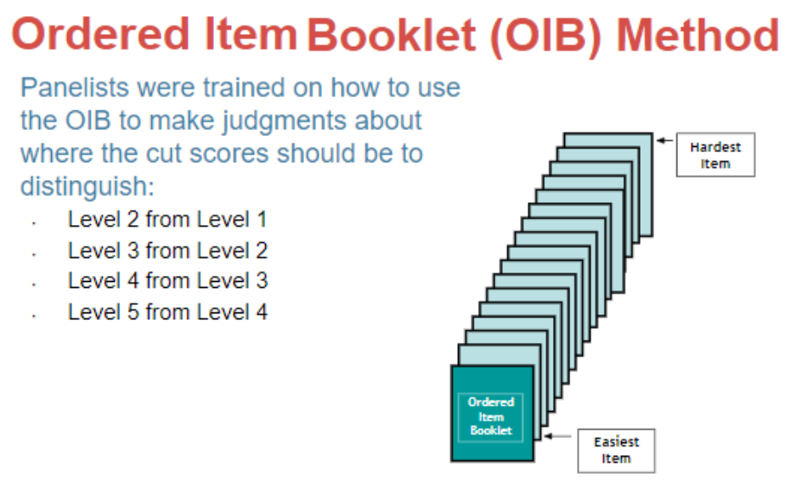

Slide 13
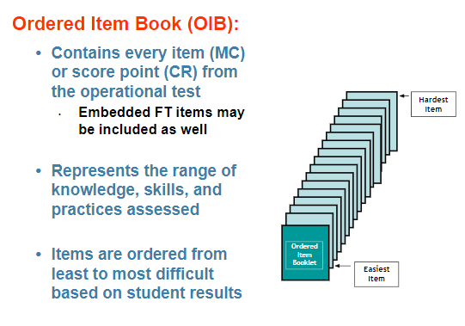

Slide 14
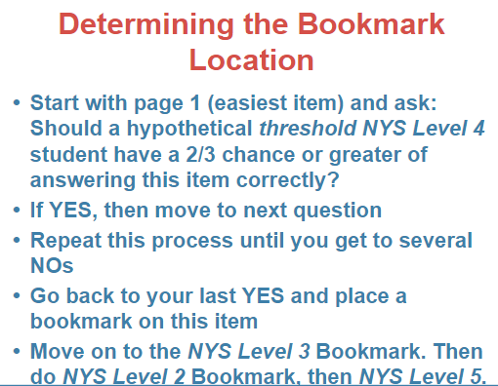

Slide 15
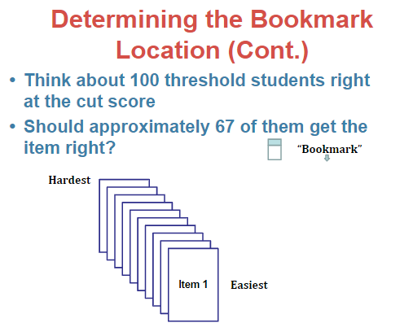

Slide 16
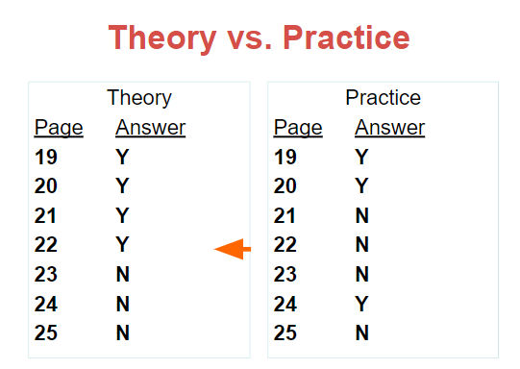

Slide 17
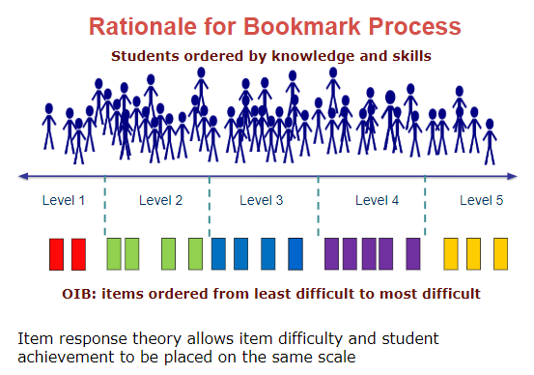

Slide 18
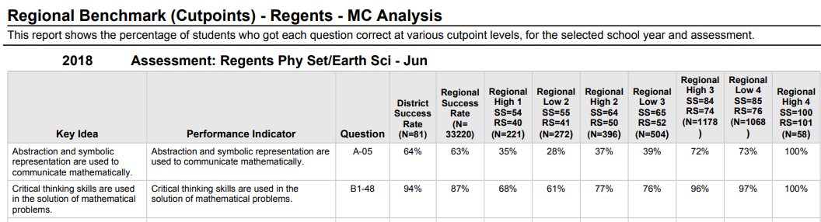
WNYRIC Question difficulty report
1. Took our Regional Benchmark Cutpoint Report
2. Looked at the low 3 cut values, and the low 4 cut values, so the kids that were on the cusp of proficiency levels.
3. In the low 4 column, highlighted all the values that were lower than 67%, these are the level 4 questions-questions meant to be challenging for top students.
4. Did the same with the low 3 column, these are level 3 questions, anything not highlighted are level 1 and 2 questions.
For Common Core assessments, Level 5 questions were identified using the low 5 column.

Slide 19
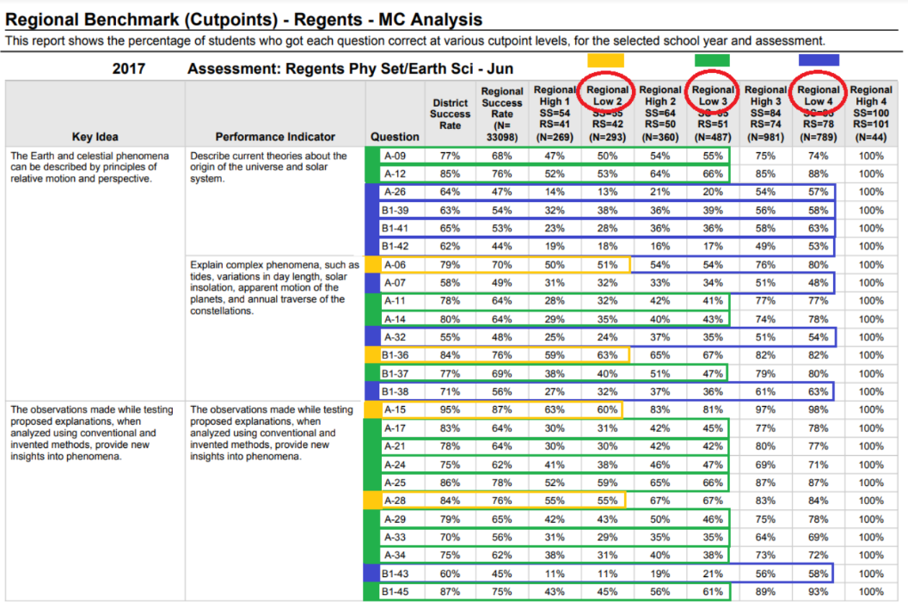
Text

Slide 20
